Slide 1
Geocoding Explorations in Python
…or, trying to answer: “Where are the bounding boxes coming from?”

Slide 2
What I found
Boston

Slide 3
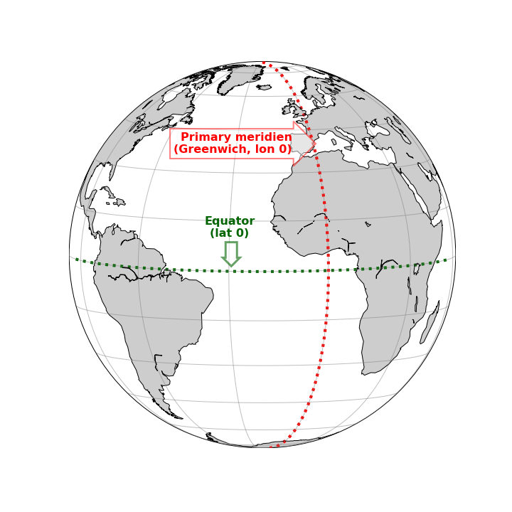
Main Problem: 3D > 2D, i.e. mapping

